Slide 1
Fling Machine
By: Addison Matthews and Tim Shoul

Slide 2
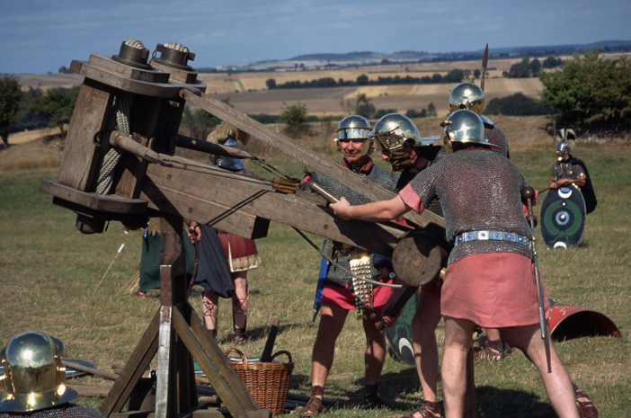
Introduction

Slide 3
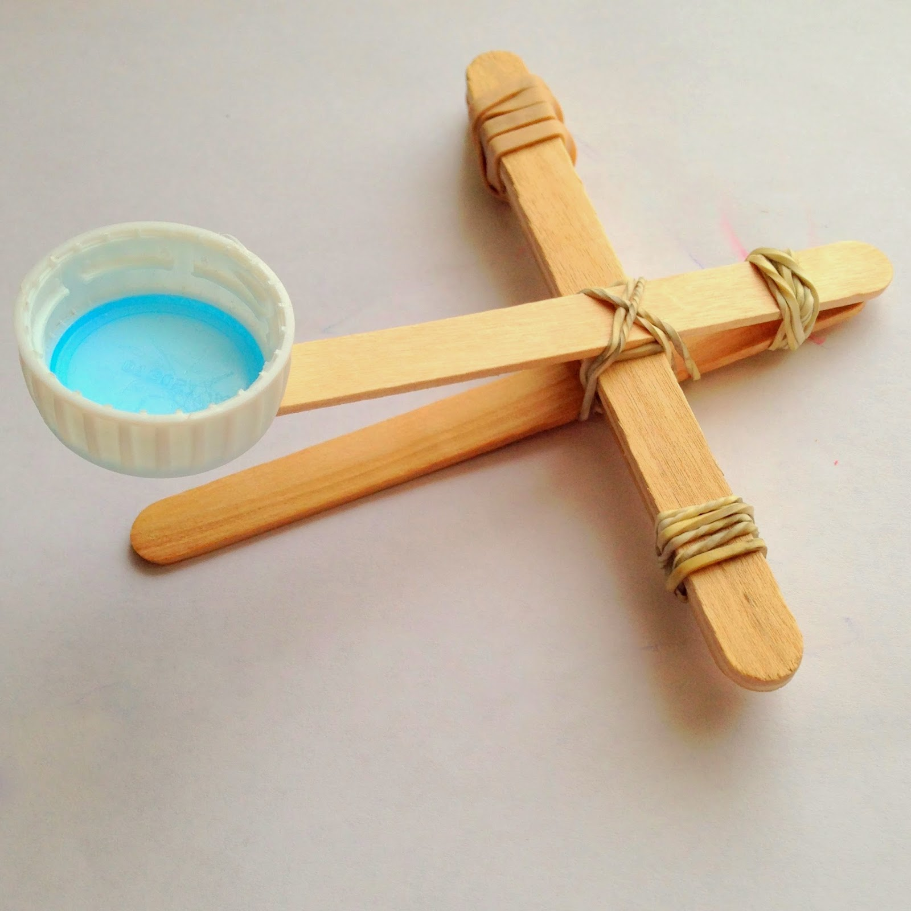
Designing It
The goal was to construct a machine that would launch a ping-pong ball 10 feet every time we fired it. We also wanted this to cheap and easy to build.
We generated concepts that roughly matched what we saw online.

Slide 4
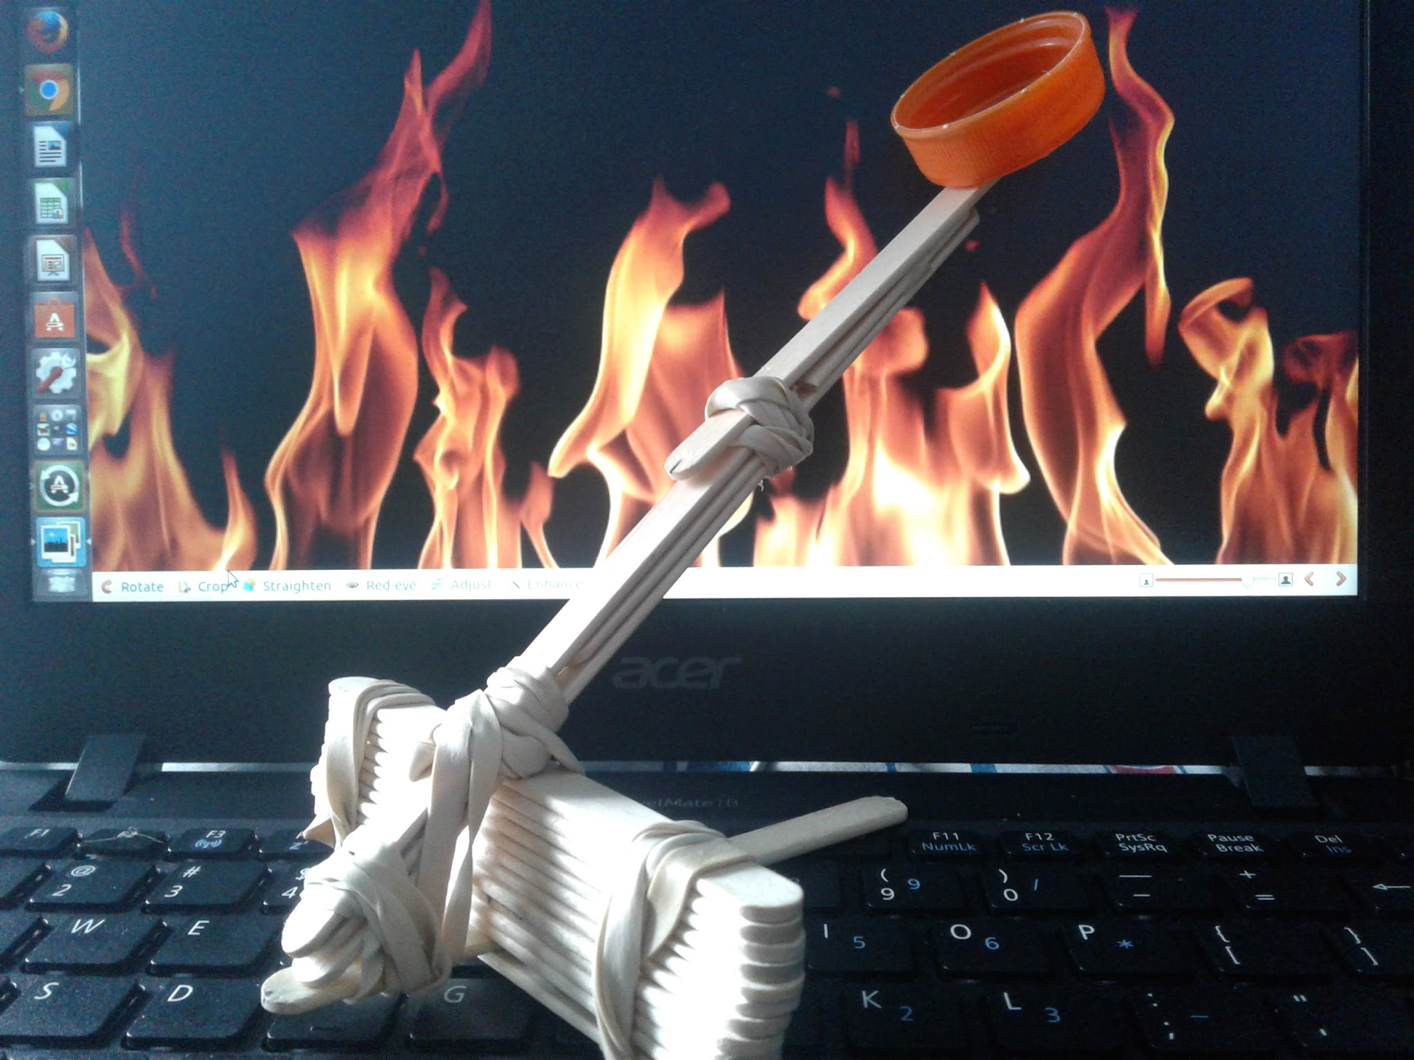
Designing It
Our solution was to construct our concept but with a larger lever to shoot the ping-pong ball further.
This was our prototype.

Slide 5
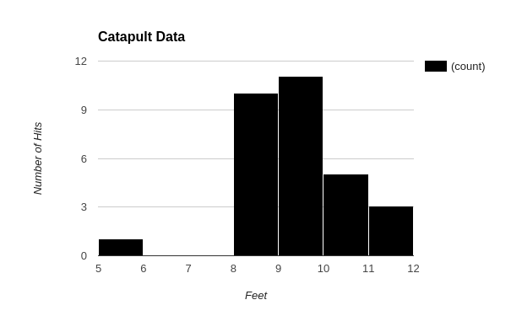
Analysis for Prototype
Average: | 9.337333333
Median: | 9.25
Mode: | 8.83
Minimum: | 5
Maximum: | 11.25
Standard Deviation: | 1.130452864

Slide 6
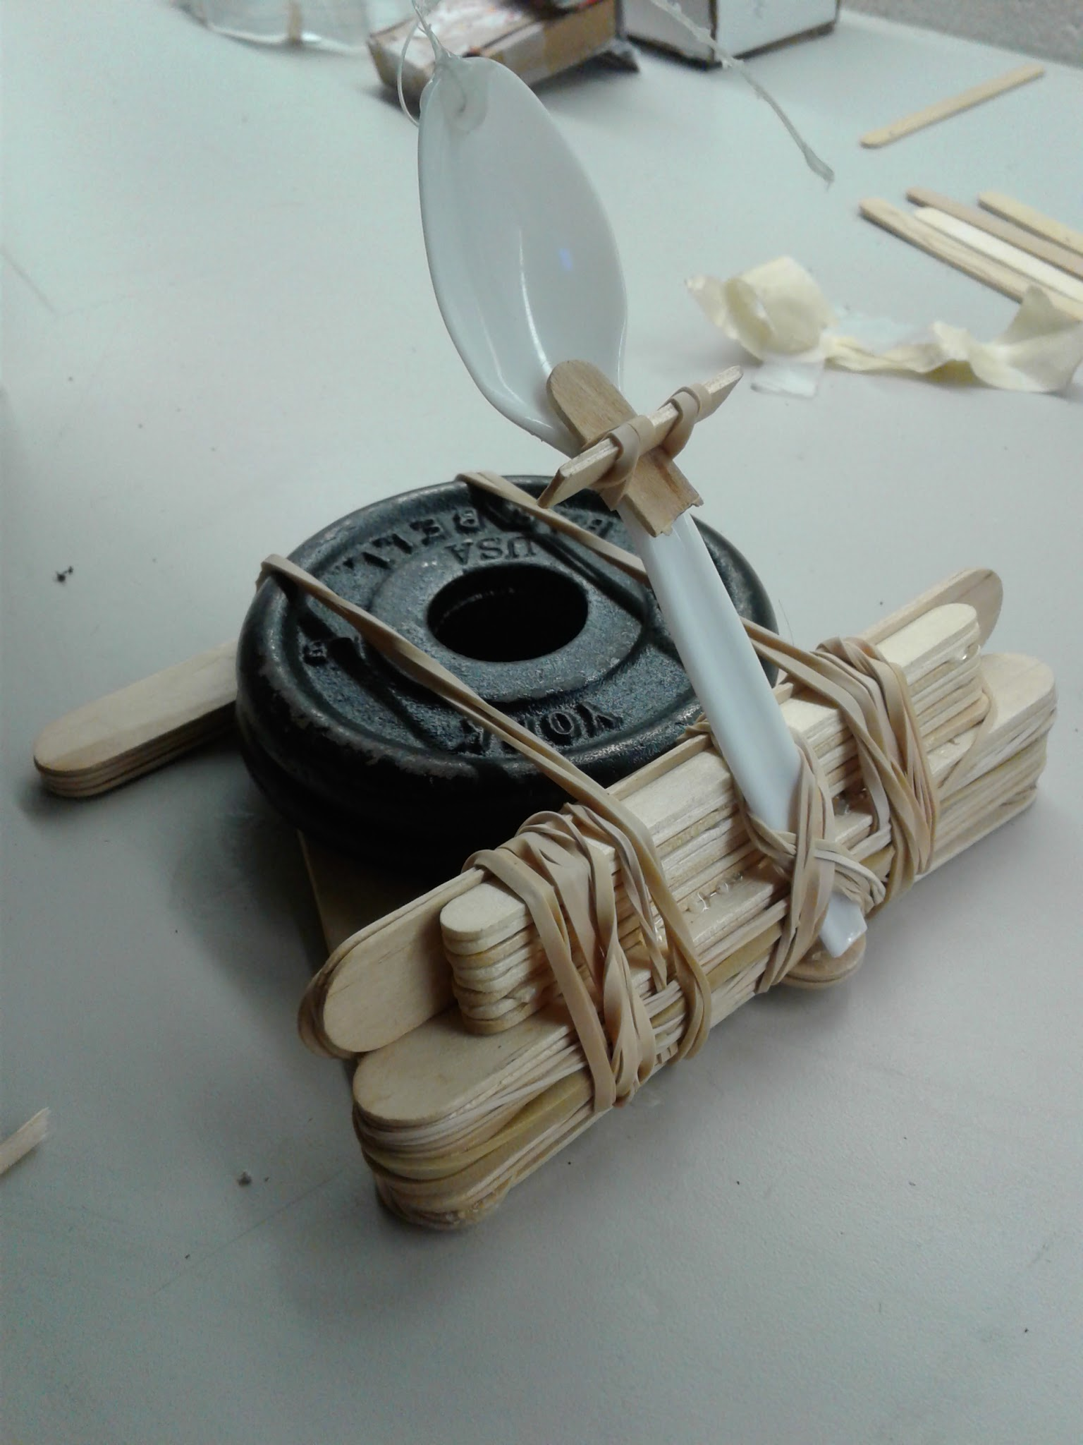
Improvements
We decided to use a spoon instead of an arm and added some sticks to make it sturdier. We also chose to put weights on the bottom to hold it down.

Slide 7
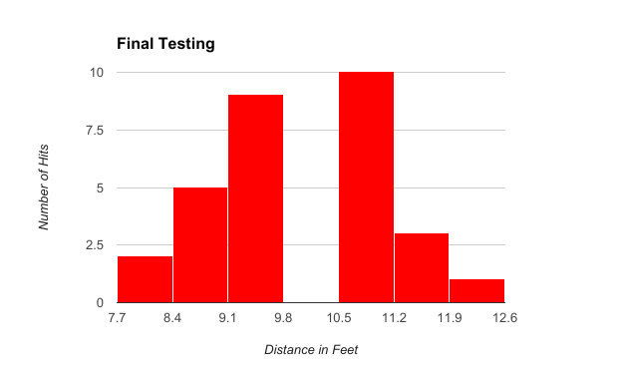
Analysis for Final Product
Average: | 10.00933333
Median: | 9.71
Mode: | 8.83
Maximum: | 12
Minimum: | 8.08
Standard Deviation: | 1.080708367

Slide 8
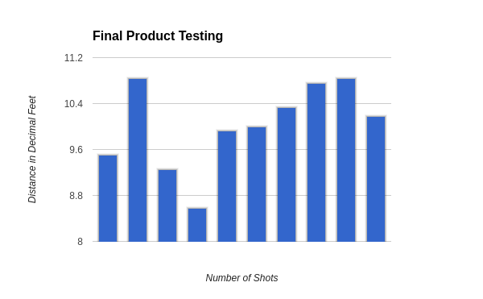
Final Testing
 | Addison | Tim S.
Attempt: | Feet | Inches | Decimal Ft
1 | 9 | 6 | 9.5
2 | 10 | 10 | 10.83
3 | 9 | 3 | 9.25
4 | 8 | 7 | 8.58
5 | 9 | 11 | 9.92
6 | 10 | 0 | 10
7 | 10 | 4 | 10.33
8 | 10 | 9 | 10.75
9 | 10 | 10 | 10.83
10 | 10 | 2 | 10.17
 | Mean Average: |  | 10.02
 | Stnd Error: |  | -0.02
 | Sample Stnd Dev |  | 0.74
 | Median: |  | 10.08
 | Mode: |  | 10.83
 | Sum: |  | 100.17
 | Count: |  | 10
 | Minimum: |  | 8.58
 | Maximum: |  | 10.83
 | Range: |  | 2.25

Slide 9
“Take-A-Ways”
Multiple test make for the best final product
Teamwork is key to the perfect project
Time management is crucial

Slide 10
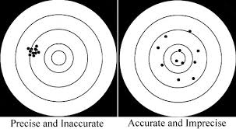
Final Outcome
Our catapult was more accurate than it was precise. We hit 9 out of 10 in the target zone, but the shots varied throughout the zone. So while we may not have been precise, we were incredibly accurate.

